Slide 1
Design a Compelling AI Vision That Improves Sales Outcomes
Notes:
Ver 2022-0304
Presenter's Name
Presenter's Name

Slide 2
Start With Your Sales AI Ambition
The sales AI ambition states the how behind the commercial organization’s intentions to use AI to improve productivity and the customer experience. Ambition is made up of multiple initiatives, supporting a larger AI strategy, that describe how AI should be used to simplify specific areas related to the buying journey by either being customer-facing or operational behind the scenes.
Notes:
Setting an AI vision for the sales organization must start with understanding and clarifying your organizations AI ambition.
AI ambition is not about asking for budget allocation or creating separate initiatives. It is about building a cohesive story/vision for how investing in AI supports the organization's ability to meet customer needs in the present and future. It must tie into the overall business strategy, not exist as a siloed plan.

Slide 3
Instructions for Use
CSOs can leverage this tool as a brainstorming aid for communicating sales AI ambition and/or facilitating discussion with stakeholders. It includes:
Questions CSOs must answer
Pre Workshop research
Relevant stakeholders to consider
Workshop execution advice
Hypothesis planning for sales AI investment value
A completed example
Supporting research to help you get started
This is best used to support a workshop; however, it can be done outside of one. Keep in mind, the goal is to build a multi slide deck that includes a plan for each potential project and how it aligns to the overarching objective of improving sellers' ability to meet buyer needs.
1
Step 1: Pre Workshop Research
2
Step 2: Mapping your Stakeholders
3
Step 3: Connecting to the Buying Journey
4
Step 4: Defining your AI Ambition
5
Step 5: Build AI Ambition Deck
6
Step 6: Plan for Communication

Slide 4

Execution Advice
Formatting: This is supplied as a PPT but is best recreated within a whiteboarding workshop/virtual whiteboard application.
Where to start: Capture current projects to identify gaps prior to mapping future or ideal projects.
Terminology: Ensure language within tool aligns with the language of broader AI-focused company initiatives.
Completion: Every column is not necessary if it’s not in alignment with your project.
Notes:
As noted in the instructions, while this can be done using the PPT template provided, it is best suited for a visual collaboration tool or virtual whiteboard. The above is an example of what this might look like in a visual collaboration tool

Slide 5
Questions CSOs Should Ask Themselves
Where can everyday AI help customers navigate their buying journey and make confident decisions?
Everyday AI are those focused on task automation and streamlining processes.
Where can game-changing AI improve both the buying experience and conversion rates?
Game-changing AI are those focused on driving transformation and innovation.
What are the key metrics and seller behavior changes required for investments to have an impact?
How does our sales AI ambition align with other existing organization and sales objectives?

Slide 6
Preworkshop Research
1
Step | Research | Guidance
Understanding the Buying Journey | Focus on Buying Jobs Rather Than the Chaos of Buying Journeys | AI investments, whether identified as productivity gainers or game changers, should have measurable impact on the buying experience that sellers deliver to buyers. When mapping each of your projects, you’ll need to connect its impact to specific jobs within the buying journey that will see change.
Define Your Sales AI Use Cases | 13 Generative AI Use Cases for B2B Sales | Focus on use cases where AI deployment provides for productivity gains or supports transformation of the sales organization. Use cases must also be feasible for your organization to deploy.
Mine Key Seller Actions | Drive Frontline Sales Productivity With an AI-Powered Seller Action Hub | At a high level, map seller workflows and the actions they take to complete them. Focus on daily tasks, both customer-facing and non-customer-facing, related to data entry, report generation and customer interactions. Notate ones that impact deal progression within the buying process.
Audit Your Sales Technology Stack | A CSO’s Guide to Optimizing Revenue Technology Stacks for Pipeline Growth | Map your understanding of the current sales tech stack components that support AI use cases. Ensure you include any integration and data dependencies as well as the sales process they are linked to.
Identify Metrics | Create Use Cases to Build a Better Sales Technology Roadmap | Center this around the business outcome(s) you intend to impact with your AI investments. Gather the quantifiable metrics and KPIs as well as the org-level, function-level or user-level decisions these investments will support.
Sales AI Strategy | Generative AI Strategic Planning Essentials for B2B Chief Sales Officers | Define a high-level strategy for AI’s impact on sales that can be workshopped into a compelling and comprehensive strategy that links initiatives back to desired sales outcomes.
Notes:
An effective workshop will require you to bring foundational elements for consensus building and discussion. Use these assets and guidance to build out those elements.

Slide 7
Mapping Your Stakeholders
2
Primary Internal
Primary External
Secondary Internal
Secondary External
Sellers
Prospects
IT
Vendors
Frontline Sales Managers
Data & Analytics
Third-Party Professional Services
Customers
Sales Operations
Sales Leadership
Marketing
Finance
Sales Enablement
Legal/Privacy/Risk
Notes:
Communicating your AI ambition will require you to tailor your message based on who is affected as well as your audience. Group stakeholders into 4 categories:
Primary Internal – These are roles/teams/functions most directly affected/impacted by AI investments. Direct users, or those who manage and/or partner with direct users.
Primary External – These are the persons/organizations who will be directly impacted by direct users' adoption of AI investments.
Secondary Internal – These individuals/roles/functions are not directly using or coaching users on AI use but will have a responsibility in communicating value, ensuring proper integration or evaluating/approving budget needs.
Secondary External – These individuals/organizations may not be directly influenced by direct users, but the impact AI adoption has on your organization and/or buyer landscape will affect their viewpoint or future roadmaps.

Slide 8
Connecting to the Buying Journey
3
 | Problem Identification | Solution Exploration | Requirements Building | Supplier Selection
Hypothesis
Metrics
Use Case(s)
Key Seller Actions
Sales Tech to Consider
Sales AI Strategy | Vision
 | Drivers
 | Outcomes
Notes:
The intention of this slide is to highlight the different elements a sales leader must consider to connect AI-enabled tech to its impact on the buying journey. In the following slides we will expand on what each element means and what is required to build them.
Connecting these elements for a single project across the buying journey ensures that AI investments are targeted, strategic and directly address buyer and seller needs within the buying process. It enables stakeholders to understand how AI will support customer-facing roles efforts across those jobs and make their interactions more relevant and impactful. Each project will not touch the entire buying journey; focus on the specific jobs within the journey that will be impacted.
Internally, the goal is to demonstrate a clear framework that focuses the organization on how sales AI investments can optimize processes, improve efficiency and allocate resources more effectively, leading to a more streamlined and data-driven approach. Stakeholders can visualize how customer-facing teams will be empowered to focus on high-value activities that drive revenue growth and reduce costs.
Externally, aligning AI initiatives with the buying journey enhances the customer experience. Buyers experience more personalized, timely and relevant interactions, allowing them to feel understood and focus on identifying the value their teams can derive from your solution. They receive tailored solutions and data-driven insights that build stronger relationships and improves brand loyalty. Suppliers can differentiate themselves from competitors through a seamless and engaging buying experience.

Slide 9
Defining Your AI Initiatives
4
Sales AI Strategy
Sales AI Use Cases
Key Seller Actions
The way AI will drive strategic value and contribute to the company’s future through transformation
The specific scenarios in which AI investments can be feasibly applied to achieve sales objectives and goals and whether they're everyday AI or game-changing disruption
The granular units of work required to make optimal AI design choices
AI-enhanced Sales Tech
Hypothesis and Metrics
AI-driven tools and platforms that support the automation, management or optimization of the processes associated with use cases
Prediction on the impact of desired AI investments, and the quantifiable measurements that will track and assess performance against hypothesis

Slide 10
Deep Dive: Capturing the Hypothesis
Define the Desired Outcome
Capabilities
Features and Functions
Test and Refine Hypothesis
Final Hypothesis
What are potential key outcomes that AI could support?
What capabilities are necessary for users to achieve this?
What AI features and functions support capability development?
Use scenario planning to explore future state and potential implications.
Final determined outcome and identified implications
Example: AI-Powered Sales Forecasting
Define the Desired Outcome
Capabilities
Features and Functions
Test and Refine Hypothesis
Final Hypothesis
Enhance sales forecasting accuracy.
Interpret forecasts and adjust sales strategies accordingly.
Predictive analytics
Real-time analysis
25% improvement in forecast accuracy
10% revenue increase
Leveraging predictive analytics and real-time analysis to improve forecasting accuracy and our ability to adjust based on buyer actions will increase our revenue earnings by 10%
Notes:
A hypothesis serves as the initial proposition on how AI will enhance the buying journey through customer-facing roles. It predicts how AI will influence specific aspects of the customer buying journey, such as improving lead conversion rates, enhancing customer interactions or personalizing the buying experience. By formulating a clear hypothesis, organizations can focus their efforts on validating or refuting these predictions through quantifiable data.
A well-defined hypothesis provides a focused direction for AI investments aimed at improving business results. It helps in setting clear objectives and expectations, thereby facilitating more effective resource allocation and risk management. A hypothesis also serves as a benchmark against which the success of AI initiatives can be measured. CSOs should collaborate with sales operations, data scientists, sales analysts, sales enablement, customer success and marketing to compile internal sales data, voice of customer and industry data that can be used to form the hypothesis.
Think of building the hypothesis as statement development: By investing in AI to _________ (problem), enabling users/stakeholders to ___________ (capability) through _________________ (features and functions), then we would expect to see ______________(outcomes) that results in ___________ (business results).

Slide 11
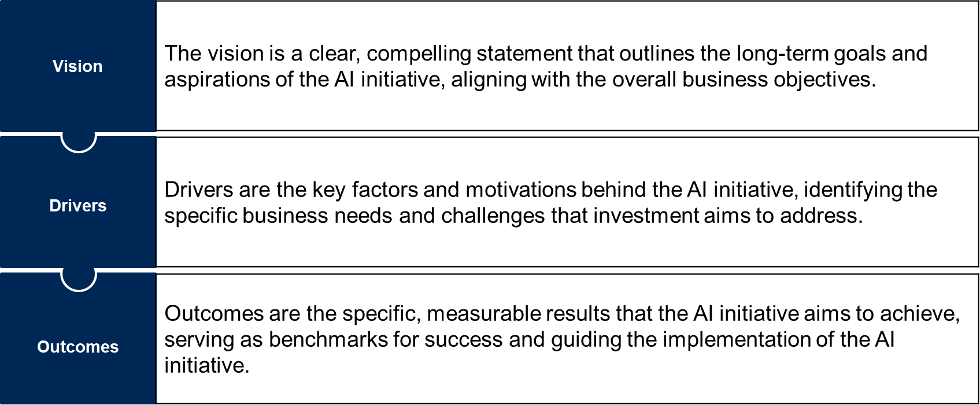
Deep Dive: Defining the Sales AI Strategy
Notes:
To effectively communicate an AI strategy and secure stakeholder buy-in, CSOs must articulate a clear and compelling narrative that encompasses the vision, drivers and outcomes of each planned initiative. This structured approach ensures that all stakeholders understand the strategic intent, the underlying motivations and the anticipated benefits of integrating AI into the sales process.
Vision: The vision should encapsulate the transformative potential of AI within the sales organization, articulating how AI will redefine sales processes, enhance customer engagement, and drive competitive advantage. It should be forward-looking, inspiring stakeholders by painting a vivid picture of a future where AI seamlessly integrates with human efforts to deliver superior sales outcomes. For instance, a vision might state, “To create a fully-integrated AI-led sales ecosystem that enhances the organization's ability to understand and anticipate buyer needs, enabling us to deliver quantifiable value and personalized experiences at scale.”
Drivers: Drivers should be rooted in a thorough analysis of current sales performance, market trends and customer behaviors. They provide the rationale for why the AI strategy is necessary, highlighting pain points such as inefficiencies in lead generation, gaps in customer insights or the need for scalability. By clearly defining these drivers, CSOs can ensure that the AI initiatives are aligned with tangible business needs and are poised to deliver measurable improvements. For example, drivers might include the need to enhance sales forecasting accuracy, reduce customer churn or streamline the sales pipeline.
Outcomes: Outcomes should be articulated in terms of both quantitative and qualitative metrics, providing a clear framework for evaluating the impact of AI on the sales organization. These could include increased sales productivity, higher conversion rates, improved customer satisfaction scores or reduced sales cycle times. By defining clear outcomes, CSOs can set expectations, track progress and demonstrate the value of AI to stakeholders. For instance, an outcome might be, "Enhance the buyer experience by reducing the complexity of the purchasing process, resulting in a 15% increase in customer satisfaction scores and a 10% reduction in the average time to close a sale.”

Slide 12
Example of Completed AI Ambition Initiative
 | Problem Identification | Solution Exploration | Requirements Building | Supplier Selection
Hypothesis | Leveraging AI to automate repetitive tasks and augment seller behavior with data-driven insights will increase seller productivity by X%, allowing them to focus on higher-value activities that will result in a X% increase in revenue.
Metrics | Lead to opportunity conversion rates | Content engagement rate | Speed of proposal development | Win rate
Use Case(s) | Market analysis | Personalized content generation or recommendation | Scenario simulation | Supplier comparison
Key Seller Actions | Precall research | Stakeholder follow-up | Debrief with champion | Assemble proposal
AI-enhanced Sales Tech to Consider | GTM data applications | Content management system | Sales engagement application | Account planning tools
Sales AI Strategy | Vision | Create a fully-integrated AI-led sales ecosystem that enhances the organization's ability to understand and anticipate buyer needs, enabling us to deliver quantifiable value and personalized experiences at scale.
 | Drivers | Improve value proposition and buyer experience. Simulate process innovation opportunities.
 | Outcomes | Achieve an increase in revenue growth by X%. Improve sales efficiency by X%.

Slide 13
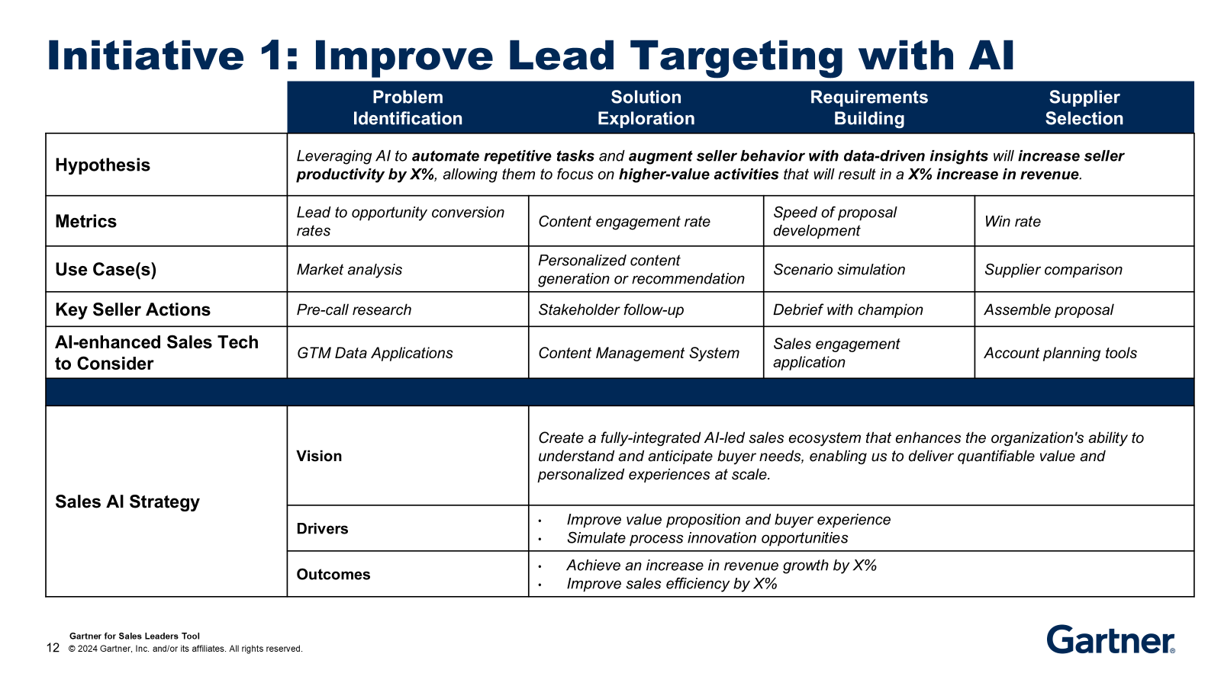
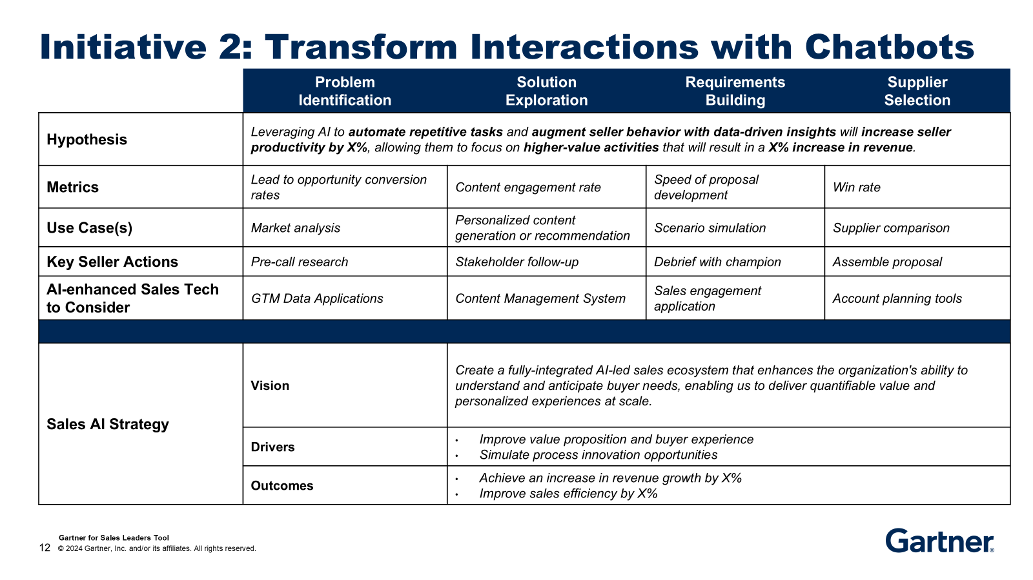

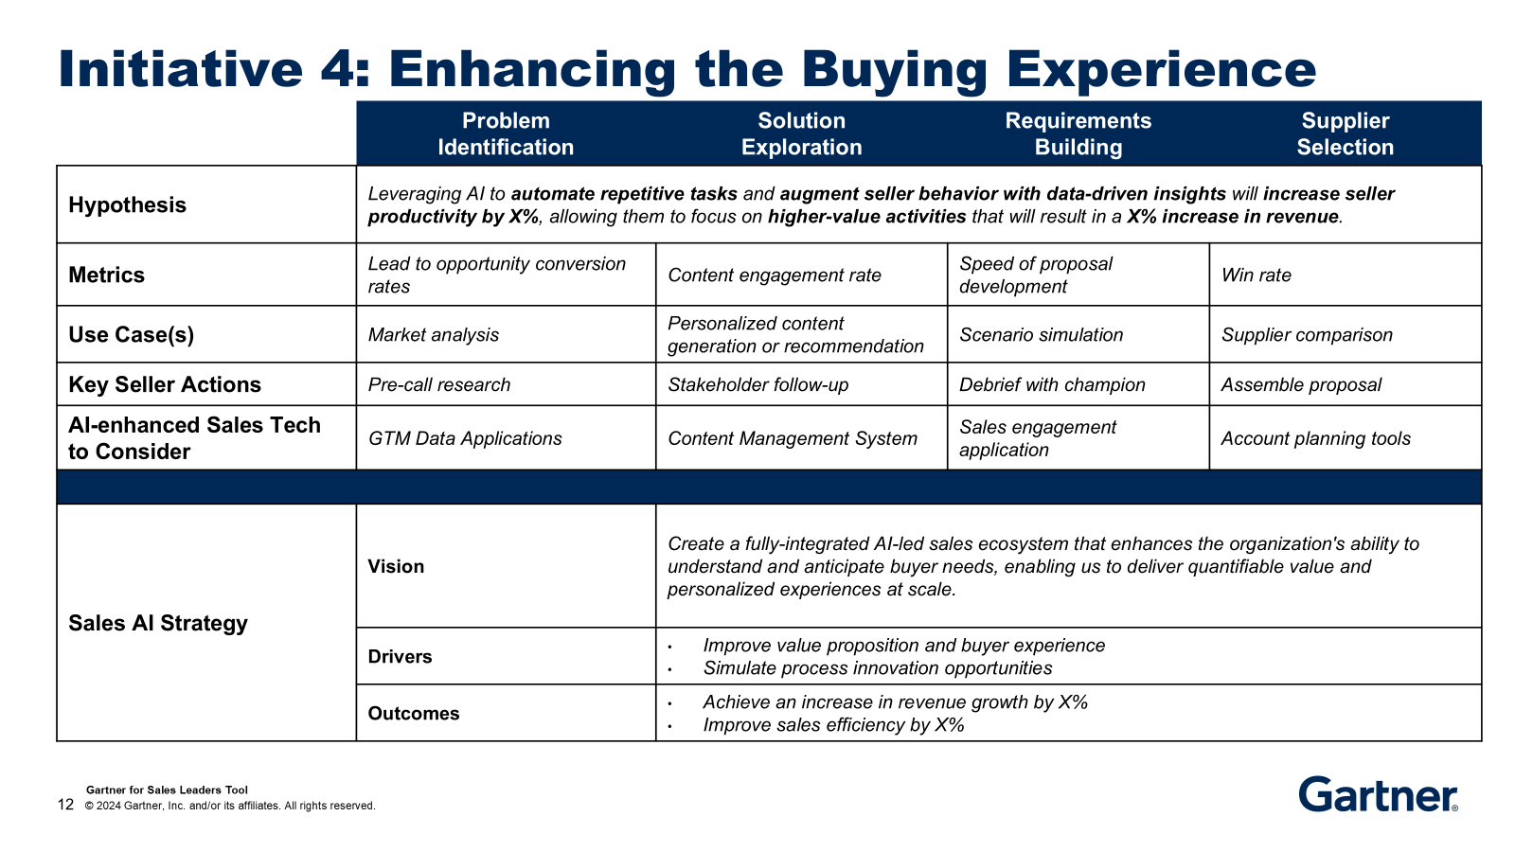
Build AI Ambition Deck
5
Notes:
As noted, the deck built to communicate your sales AI ambition should encompass multiple slides to effectively delineate the multifaceted nature of the initiative. Each slide should be dedicated to a distinct AI project, thereby providing a comprehensive overview of the various components and their respective impacts on the sales function and buyer experience. This segmented approach allows for a detailed exploration of individual projects, including their objectives, expected outcomes and potential challenges. By structuring the deck in this manner, you can ensure that stakeholders receive a clear and thorough understanding of each AI initiative, facilitating informed decision making and fostering alignment across stakeholders.

Slide 14
Plan for Communication
6
Gather a Cross-Functional AI Council: Include representation from sales, marketing, customer success and IT, as well as data science and legal/compliance. Appoint a champion to drive AI initiatives and coordination across functions. The team should manage the execution of AI investments and ensure alignment with business objectives.
Complete Your Deck With a Change Story: Including a change story in the deck is essential to illustrate the transformative journey from the current state to the desired future state, highlighting the rationale behind the AI initiatives. This narrative helps stakeholders understand the necessity of change and the specific benefits that AI will bring, thereby fostering buy-in and reducing resistance.
Develop a Business Case: Focus on the most impactful AI investments first. A business case should assess multiple options (build versus buy versus do nothing), an implementation roadmap, risks and anticipated costs.
Scope Enablement Needs: Partner with sales/revenue enablement to build a plan that ensures all relevant stakeholders receive the training necessary to develop the skills and knowledge for successful AI usage. Guide enablement toward reinforcing that training through just-in-time learning and peer-to-peer support networks.

